Slide 1
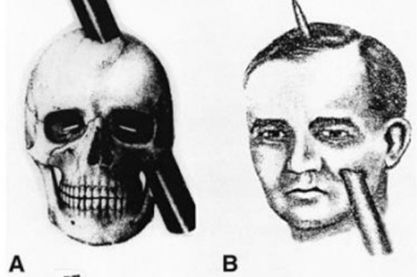
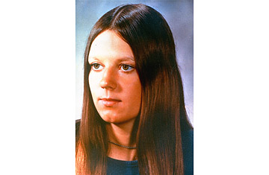
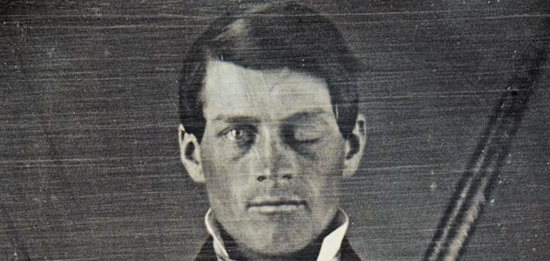
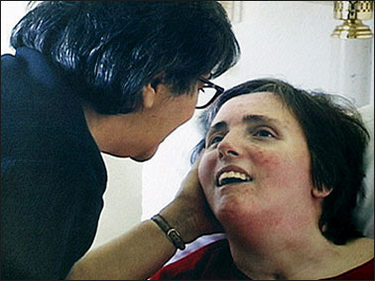

Slide 2
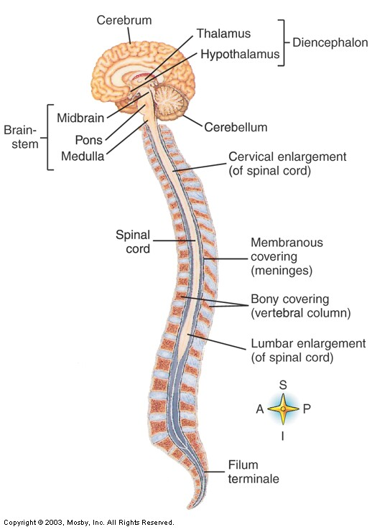
CNS
Outer Coverings
Brain
cranial bones
Spinal Cord
vertebrae
Inner Coverings
Meninges
Dura mater
Arachnoid membrane
Pia mater

Slide 3
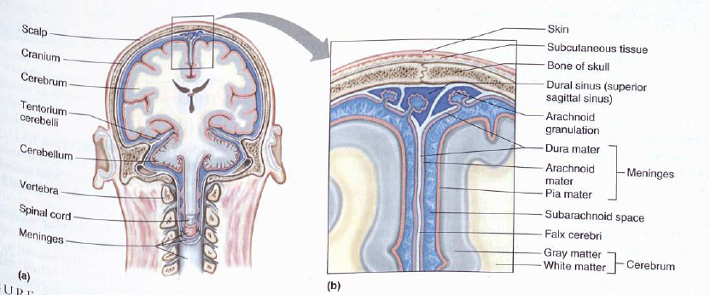
Meninges
Membranes that protect brain and spinal cord

Slide 4
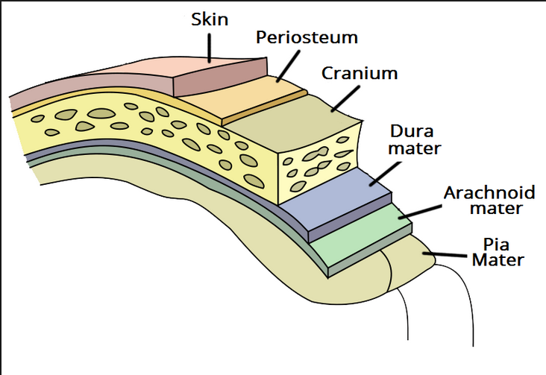

Slide 5
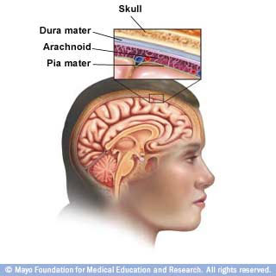

Slide 6
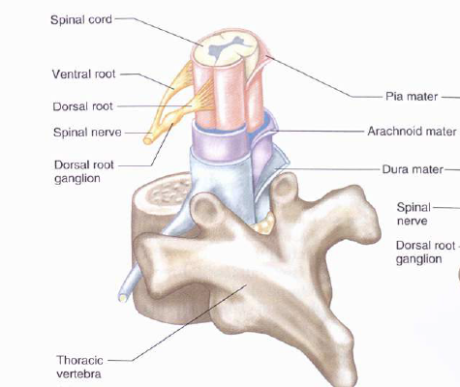
Meninges
Dura Mater
Outer layer
Strong, white fibrous tissue
Blood vessels
Arachnoid Mater
Middle layer
Delicate, cobwebby
Pia Mater
Inner layer (adheres to outer surface of brain and spinal cord)
Transparent
Contains blood vessels

Slide 7
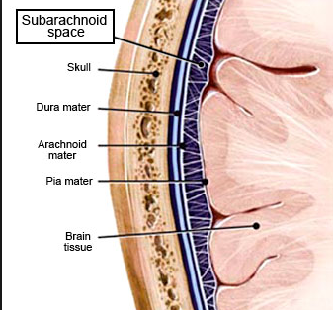
Meninges Spaces
Epidural Space
Between dura mater and bony covering of brain and spinal cord
Supportive cushion of fat
Subdural Space
Between dura mater and arachnoid mater
Lubricating serous fluid
Subarachnoid Space
Between arachnoid and pia mater
Contains cerebrospinal fluid (CSF)

Slide 8
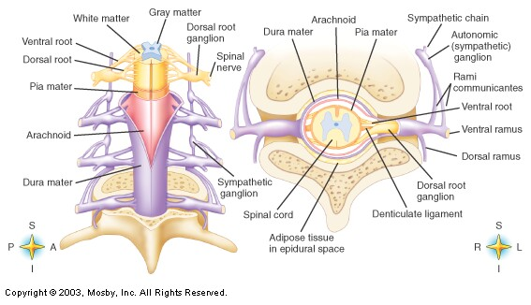

Slide 9
Meningitis

Slide 10
CSF
Provides supportive, protective cushioning
Reservoir of circulating fluid
Monitored by brain to detect changes in internal environment
Located in subarachnoid space and within cavities and canals of brain and spinal cord
Average adult has 140ml of CSF

Slide 11
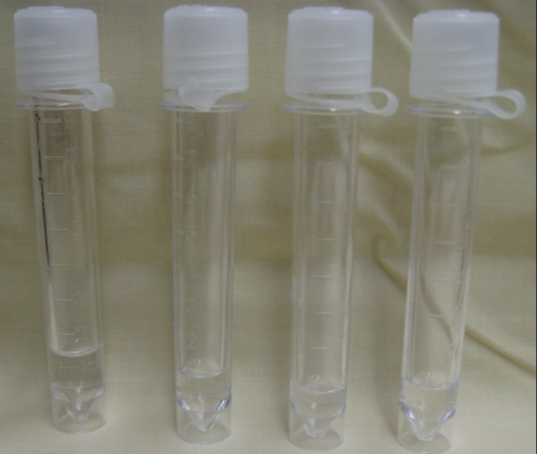

Slide 12
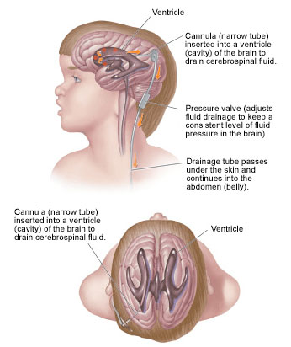
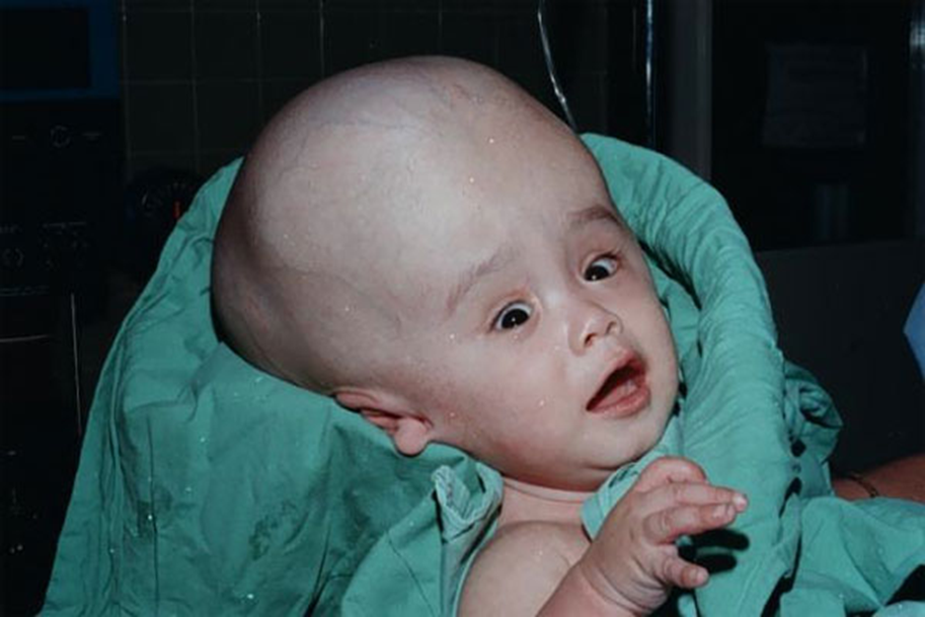
Hydrocephalus
“water head”
Sometimes in the unborn child, the drainage canal for CSF becomes stopped up.
The fluid builds up and the pressure causes the brain to expand like a balloon.

Slide 13
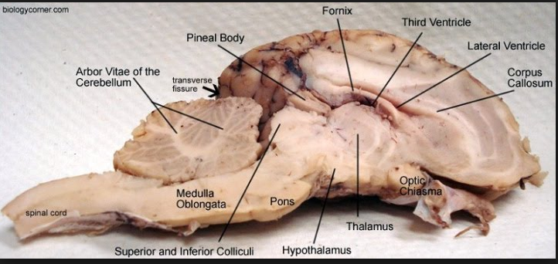
Ventricles
Cavities that are continuous with central canal
Filled with cerebrospinal fluid

Slide 14
